Slide 1
angr_ctf
2018-12-25
徐群壮

Slide 2
Outline
00_angr_find
01_angr_avoid
02_angr_find_condition
explore&Exploration_Technique

Slide 3
notes
Each binary, when run, will ask for a password, which can be entered via stdin
Goal：find a single password that works for each binary.
  incorrent password："Try again."
  corrent password："Good Job."

Slide 4
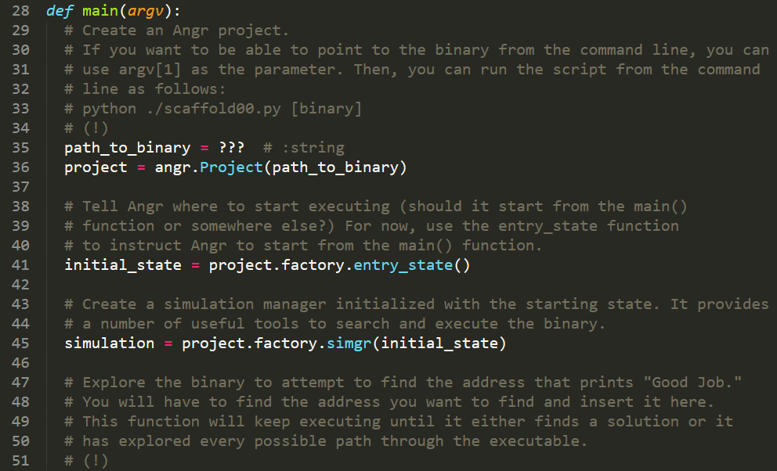
notes
scaffoldxx.py：It will offer guidance as well as the skeleton of a possible solution.

Slide 5
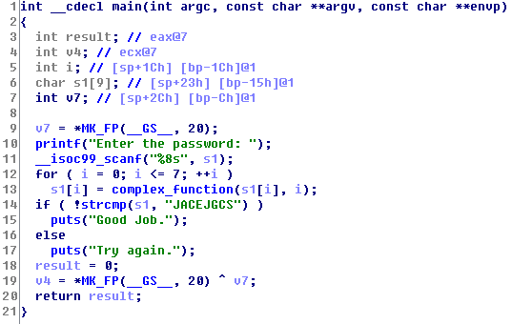
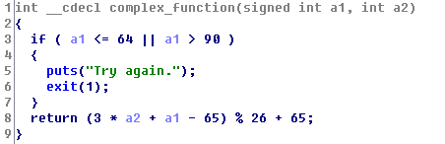
00_angr_find
Common：

Slide 6
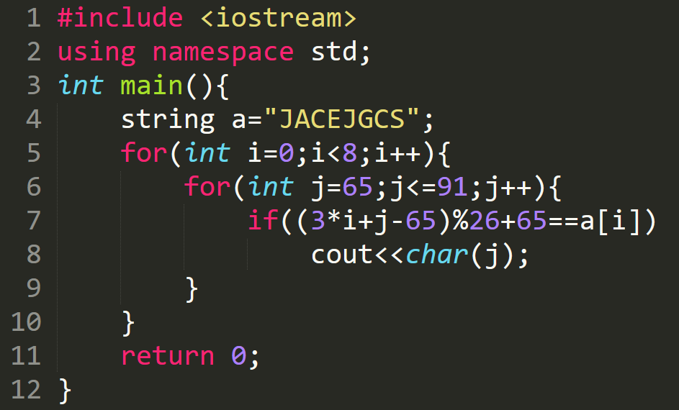


00_angr_find
procedure：
  ******** → JACEJGCS
  （3*a2+a1-65）%26+65

Slide 7


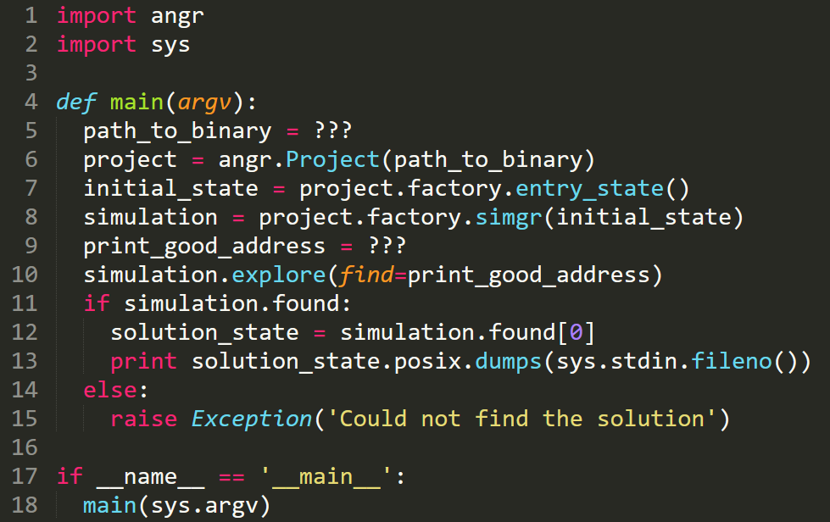


00_angr_find
angr：

Slide 8
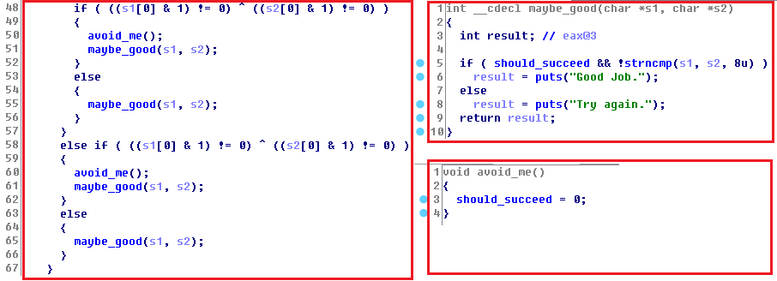
01_angr_avoid
The binary is pretty large, to save you some time,you can find a state that does not reach will_not_succeed_address.

Slide 9

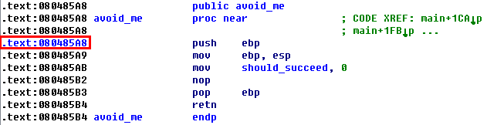

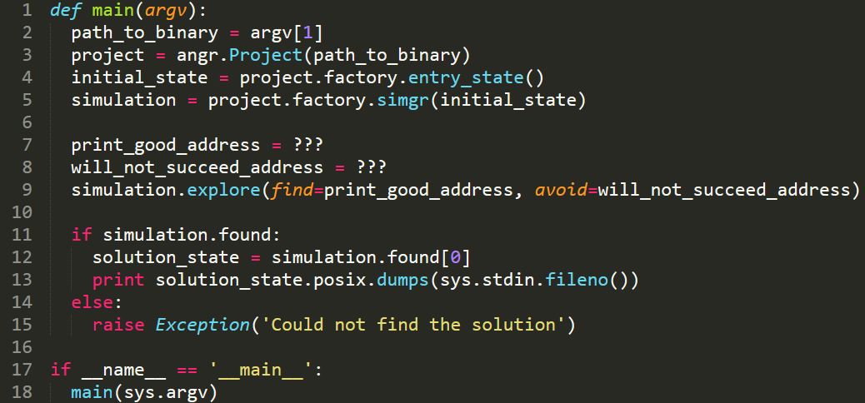

01_angr_avoid
find a state that does not reach will_not_succeed_address

Slide 10
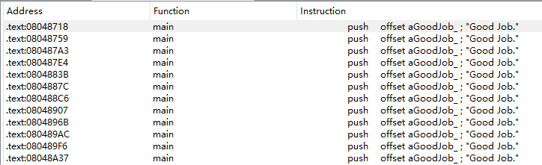
02_angr_find_condition
It is very useful to be able to search for a state that reaches a certain instruction. if not？
you don't know which instruction grants you success. Instead, you just know that you want to find a state where the binary prints "Good Job."

Slide 11


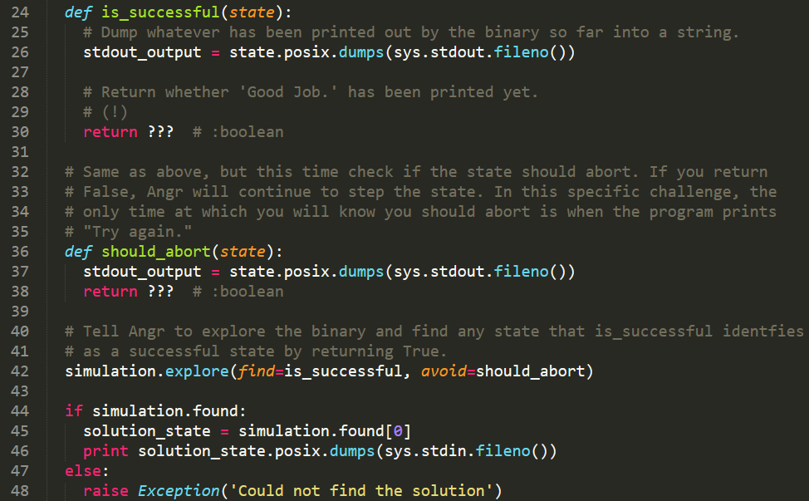
02_angr_find_condition

Slide 12
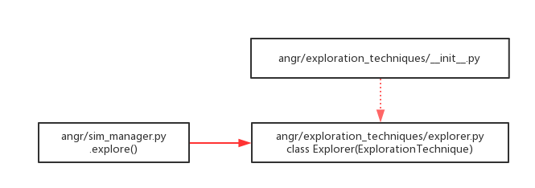
explore&Exploration_Technique
Simulation Manager's explore
Exploration_Technique's Explorer

Slide 13
explore&Exploration_Technique
.explore（）
Tick stash "stash" forward (up to "n" times or until "num_find" states are found)
looking for condition "find",avoiding condition "avoid"
  An address to find
  A set or list of addresses to find
  A function that takes a state and returns whether or not it matches.

Slide 14
explore&Exploration_Technique
Explorer(ExplorationTechnique)
__filter_inner(self, state)
  to determine whether the current state is a state of find or a state of avoid
    if not? return None
    find & (reachable?) & (Conflict with avoid?)

Slide 15
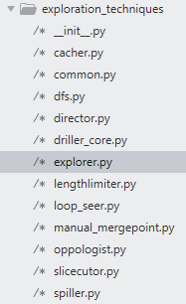
explore&Exploration_Technique
Other exploration_techniques
  Explorer：
  DFS：
  LengthLimiter：
  Threading：
  Tracer：
  ......

Slide 16
Thanks！

